Slide 1
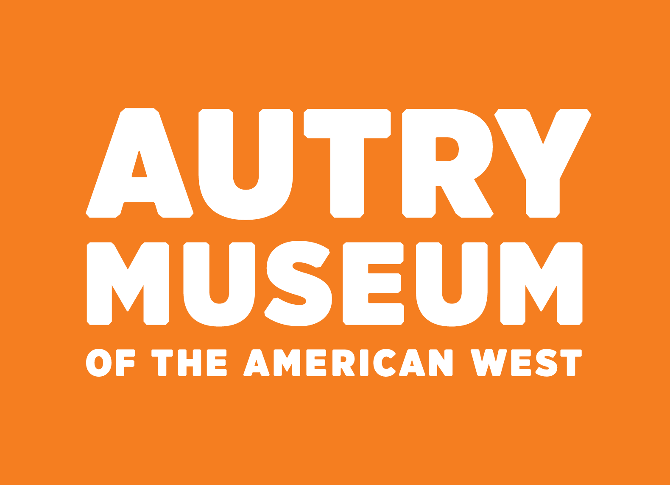
Linked Data and Collections: Exploring the Possibilities
March 27, 2019
ARLIS/NA Conference
Rebecca Menendez
Director, Information Services and Technology
rmenendez@theautry.org
Cheryl Miller
Head, Library Metadata and Discovery Services
cmiller@theautry.org
Case Study: Exploring the development and future of the Autry Museum’s ongoing project linking art and images with the publications in which their reproductions appear.
Notes:
Good afternoon. Rebecca Menendez and I are going to present a linked data case study that examines both fully curated search options and access to raw data.

Slide 2
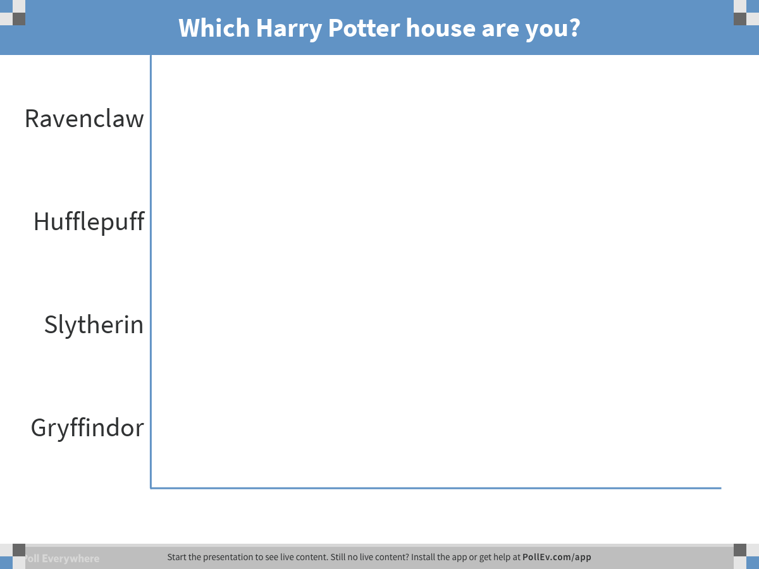
Notes:
Poll Title: Which Harry Potter house are you? https://www.polleverywhere.com/multiple_choice_polls/BHdgFafyD51Y8AHObKa6f
Cheryl: Linked Data and Collections: Exploring the Possibilities. Initially an effort to repurpose edited metadata for publishing online, and to document the impact of the museum’s collections beyond its walls, this linked data project, utilizing multiple databases, has evolved over the years into one that has created new avenues for digital humanities research.
This implementation of linked data enables a new appreciation for how collection items are used in current research, and how researchers are interpreting art, material culture, and historical images.
Also, by providing datasets in .rdf, .xlsx, .csv and .json formats, we offer researchers the opportunity to draw upon computational means to ask and answer questions and look for patterns.

Slide 3
Linked Data and Collections: Exploring the Possibilities
ABSTRACT
Initially an effort to repurpose edited metadata for publishing online, and to document the impact of the museum’s collections beyond its walls, this linked data project, utilizing multiple databases, has evolved over the years into one that has created new avenues for digital humanities research.
This implementation of linked data enables a new appreciation for how collection items are used in current research, and how researchers are interpreting art, material culture, and historical images.
Also, by providing datasets in .rdf, .xlsx, .csv and .json formats, we offer researchers the opportunity to draw upon computational means to ask and answer questions and look for patterns.
Notes:
Cheryl: Linked Data and Collections: Exploring the Possibilities. Initially an effort to repurpose edited metadata for publishing online, and to document the impact of the museum’s collections beyond its walls, this linked data project, utilizing multiple databases, has evolved over the years into one that has created new avenues for digital humanities research.
This implementation of linked data enables a new appreciation for how collection items are used in current research, and how researchers are interpreting art, material culture, and historical images.
Also, by providing datasets in .rdf, .xlsx, .csv and .json formats, we offer researchers the opportunity to draw upon computational means to ask and answer questions and look for patterns.

Slide 4
Linked Data and Collections: Exploring the Possibilities
Presentation will address:
Linking the MIMSY XG (Collections Management System) publication records to the relevant object records and to the MARC library catalog record
Object display in Autry’s Collections Online: Variant interpretations of the artifacts and images
Publication display in Autry’s Collections Online: approaching a virtual exhibition, curated by the author
How this evolved into a Collections as Data Project
What connections might future linked data and collections as data options reveal?
Creative work records in WorldCat and other databases Links in e-books and in WorldCat
Data visualization, mapping, or image analysis
Notes:
Cheryl:

Slide 5
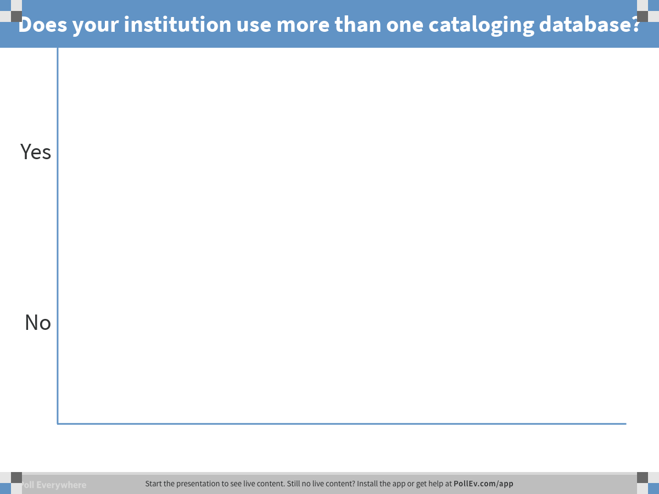
Notes:
Poll Title: Does your institution use more than one cataloging database? https://www.polleverywhere.com/multiple_choice_polls/gu6y35nxBZrGs0uwFjKFH
Rebecca:
Good afternoon.
I thought I'd start by asking:
Does your institution use more than one cataloging database?
<Please answer in the poll>
At the Autry we're currently at 3 databases, but we have had up to 4. Today, we're touching on 2 of them, as Cheryl mentioned. In our experience, one symptom that has arisen from using 2 or more databases is that we see more duplication of records representing a single item.
<react to user input> Ah, I see most of us indeed use more than one database for cataloging, so you may have experienced this as well.
<or> Ah, I see your institutions mostly use a single database, so you may have been spared a lot of the double cataloging.
So this is our story: We got started with Museum digitization in the early 2000s. As you may know, museum data isn't inherently clean, as I imagine data for published materials might be. There isn't always clear metadata standards OR easy-to-use authorities for data. Therefore, we must clean the data before publishing it online.

Slide 6
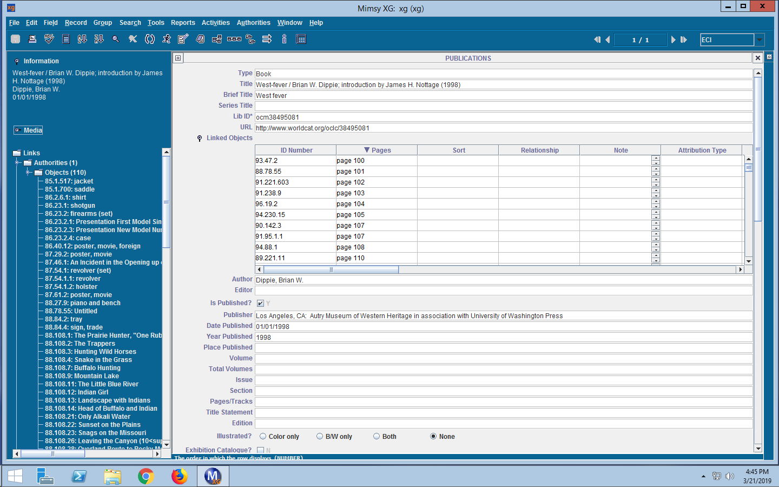
Linked Data and Collections: Exploring the Possibilities
Notes:
Rebecca:
At the Autry, we used our Collection and Exhibition Publications, with the beautifully edited captions for objects, to guide our updating and cleaning the records for objects.
Over time, the practice of recording publications in the collections management database became routine, and
we found that it had led to the creation of a data set:
objects to publications and vice versa.
As you can see here, we created a publication record for the collection overview publication, West-Fever, and we've linked all the objects reproduced in it.

Slide 7
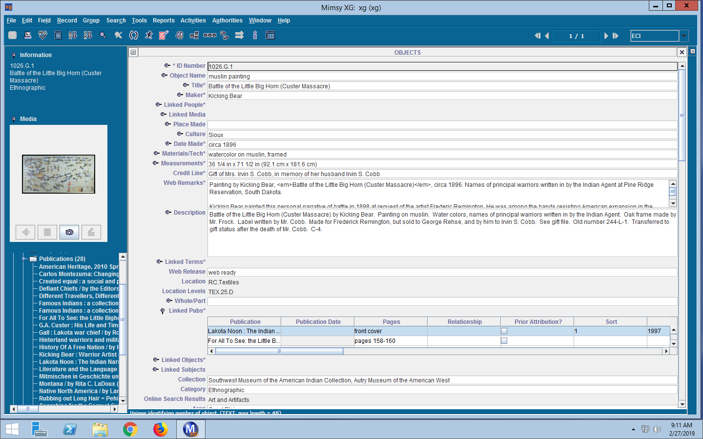
Linked Data and Collections: Exploring the Possibilities
Notes:
Rebecca
We can then click over to see each item pictured in the publication.
In each object record, we can see all the publications that item was reproduced in. This practice works well within just this database…
however by creating the publication record in the Mimsy database, we found we now have two records for the same publication. One in the library database and one in the collections management database. At first, both records appeared online. But then we thought the two records appearing for the same publication on the Collections Online website was confusing.

Slide 8
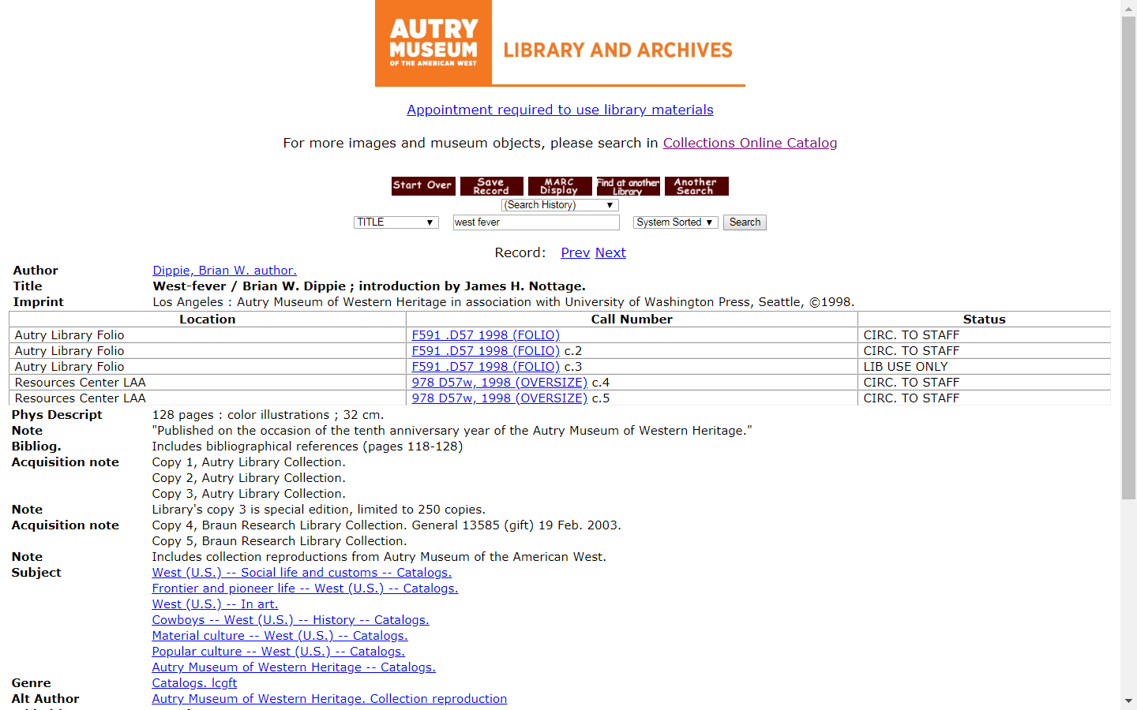
Linked Data and Collections: Exploring the Possibilities
Notes:
Rebecca
We decided to use the right tool for the right job:
the library data would be used to display records for publications, and
the Mimsy data would be used to display records for objects.

Slide 9
Linked Data and Collections: Exploring the Possibilities
Notes:
Rebecca
We did this by using the publication record in Mimsy as a pass-through:
we entered the OCLC number to link to the MARC record. We've also added the full URL for the WorldCat record.

Slide 10
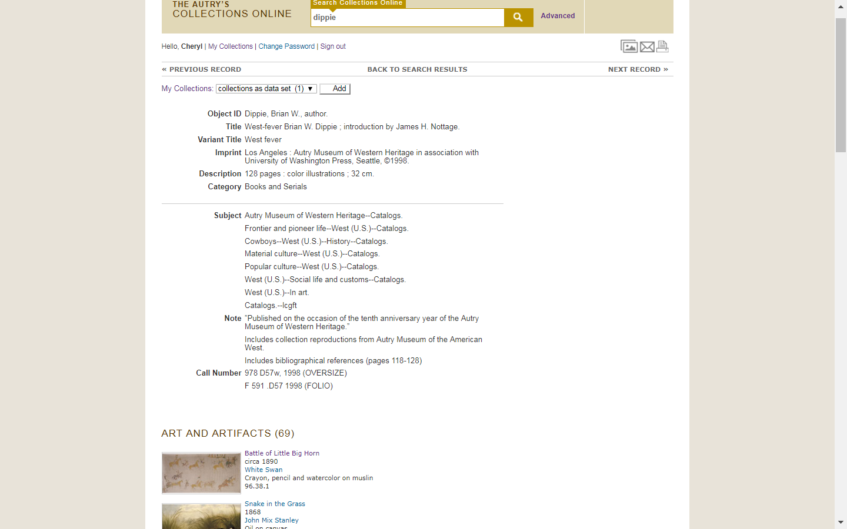
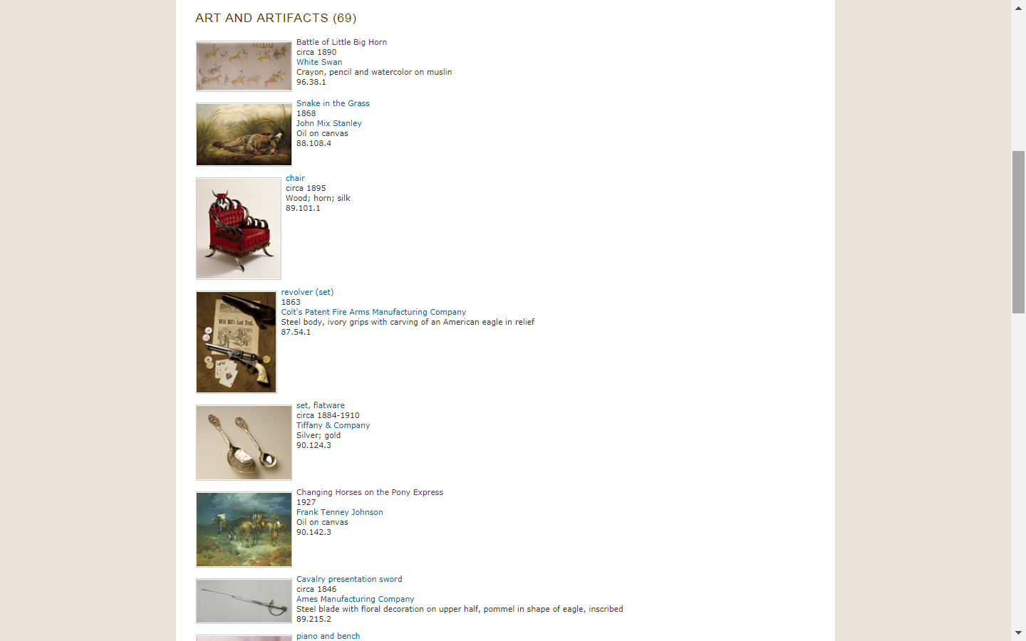
Linked Data and Collections: Exploring the Possibilities
Notes:
Rebecca:
In our Collections Online website, the pass-through has been implemented:
users will see data pulled from the library record for the West-Fever publication, and data pulled from the collections management system for the linked object records.

Slide 11
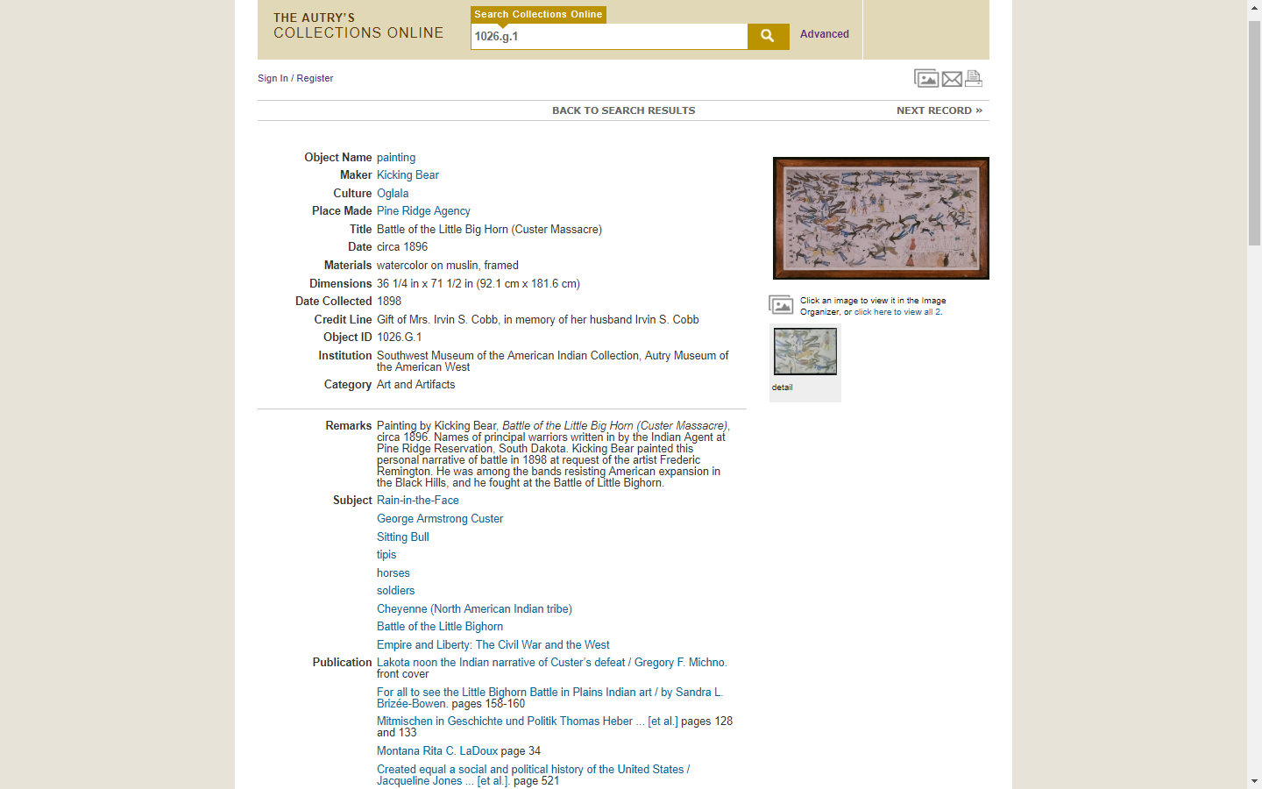
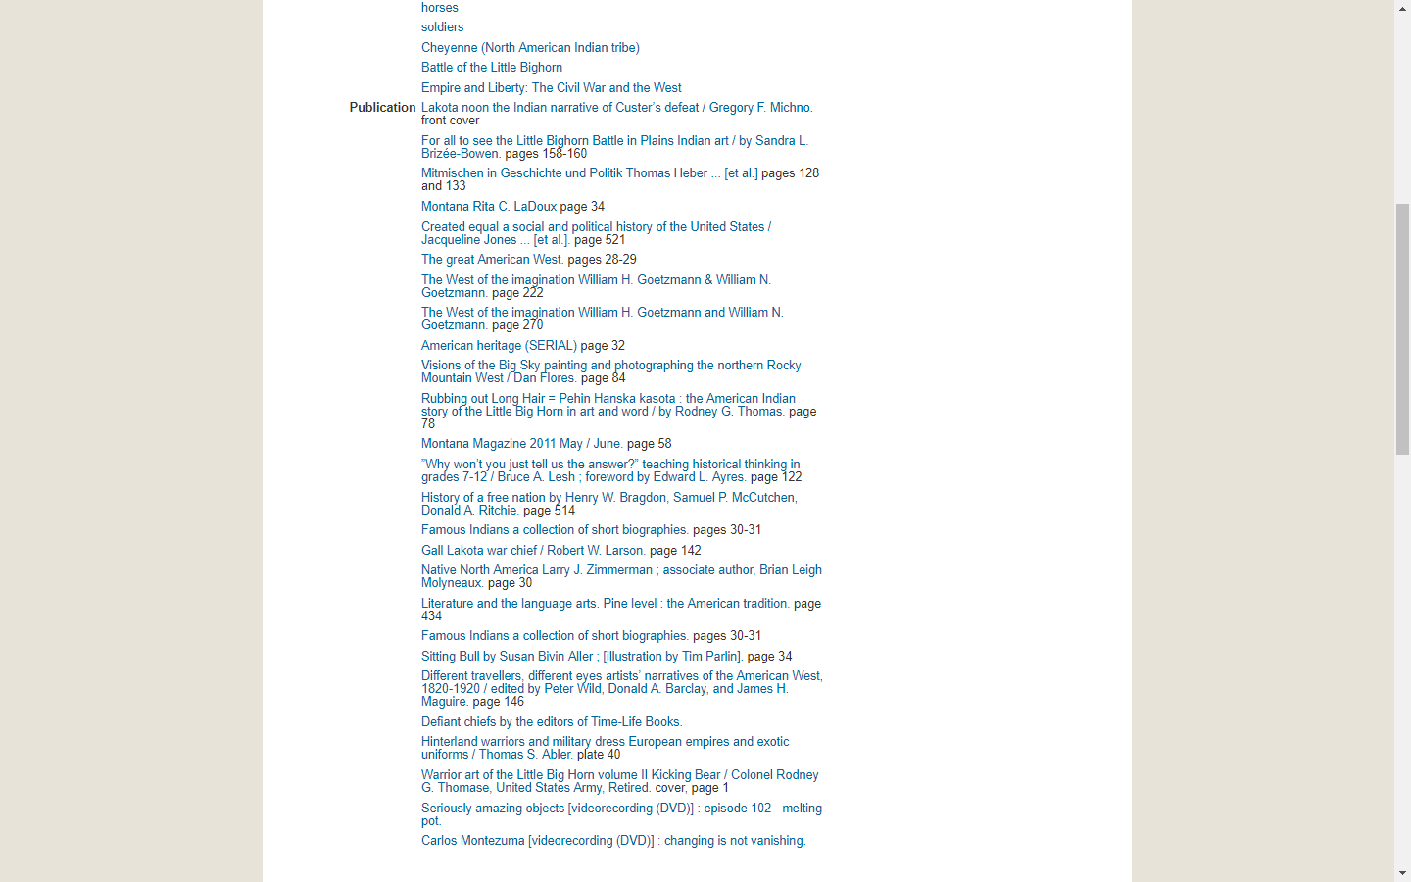
Linked Data and Collections: Exploring the Possibilities
Notes:
Rebecca / Cheryl
And again from the object record view, you can see the title/author pulling in from the library database.

Slide 12
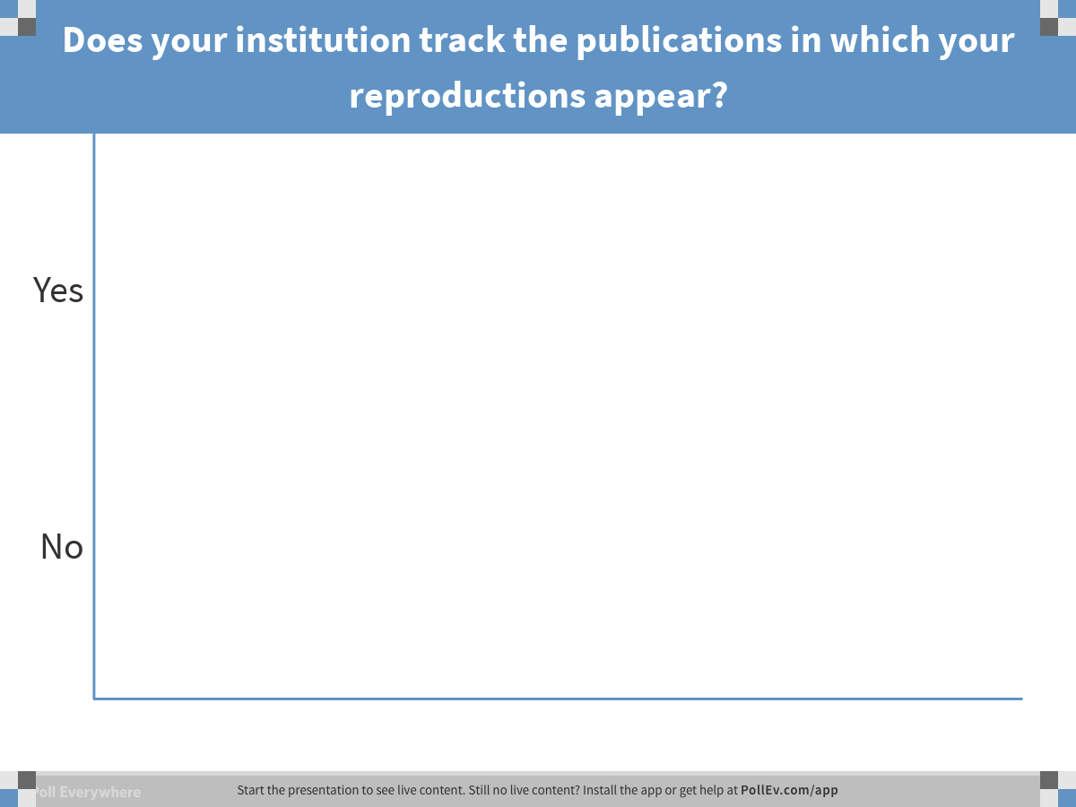
Notes:
Cheryl Poll Title: Does your institution track the publications in which your reproductions appear? https://www.polleverywhere.com/multiple_choice_polls/mn5Yw6LFLFVnFQ67e7Gse

Slide 13
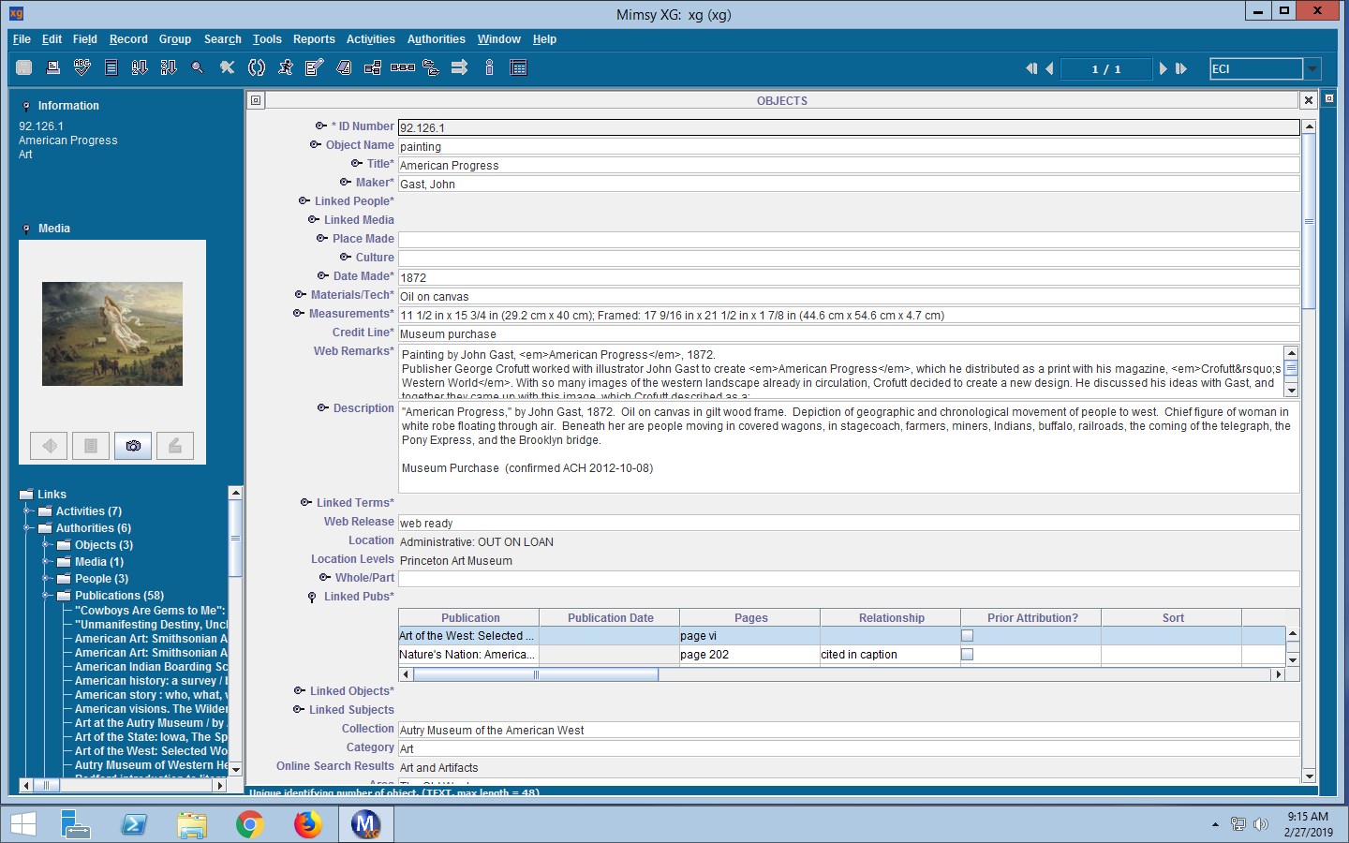
Linked Data and Collections: Exploring the Possibilities
Notes:
Cheryl:
This is another object record, this one for the painting “American Progress,” which has appeared in 58 (and counting) publications.

Slide 14
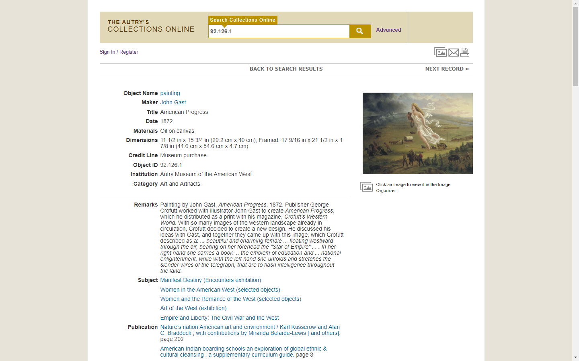
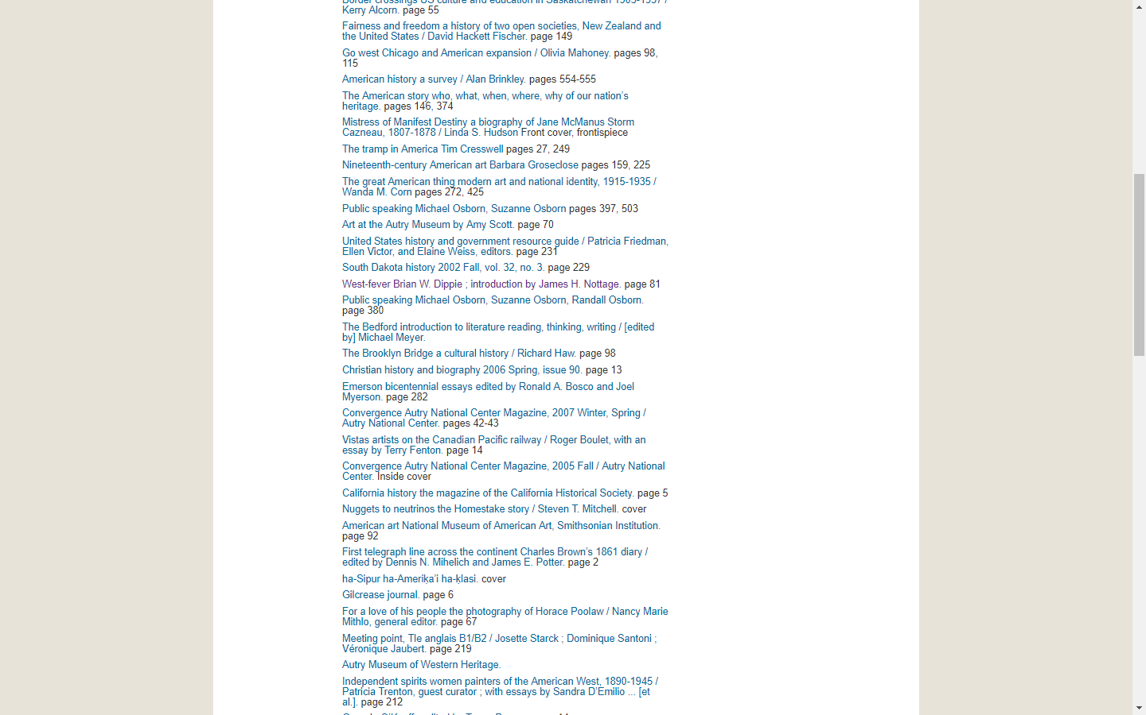
Linked Data and Collections: Exploring the Possibilities
Notes:
Cheryl
And here is the Collections Online record for the object, linked to the many, many library records for the publications in which it is reproduced.

Slide 15
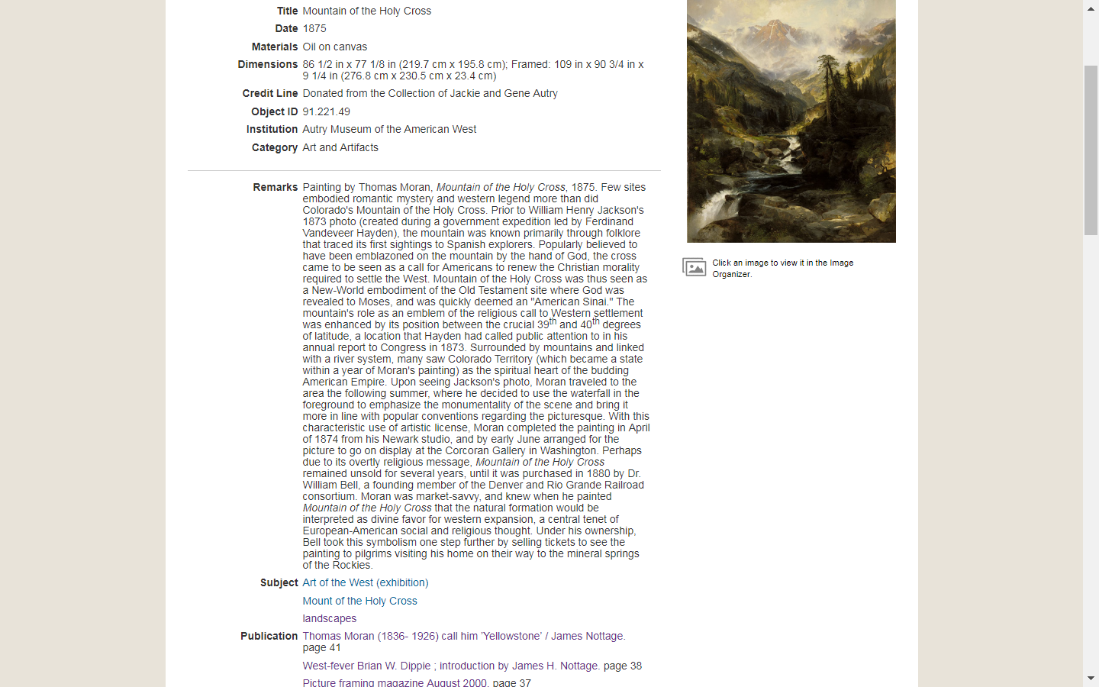
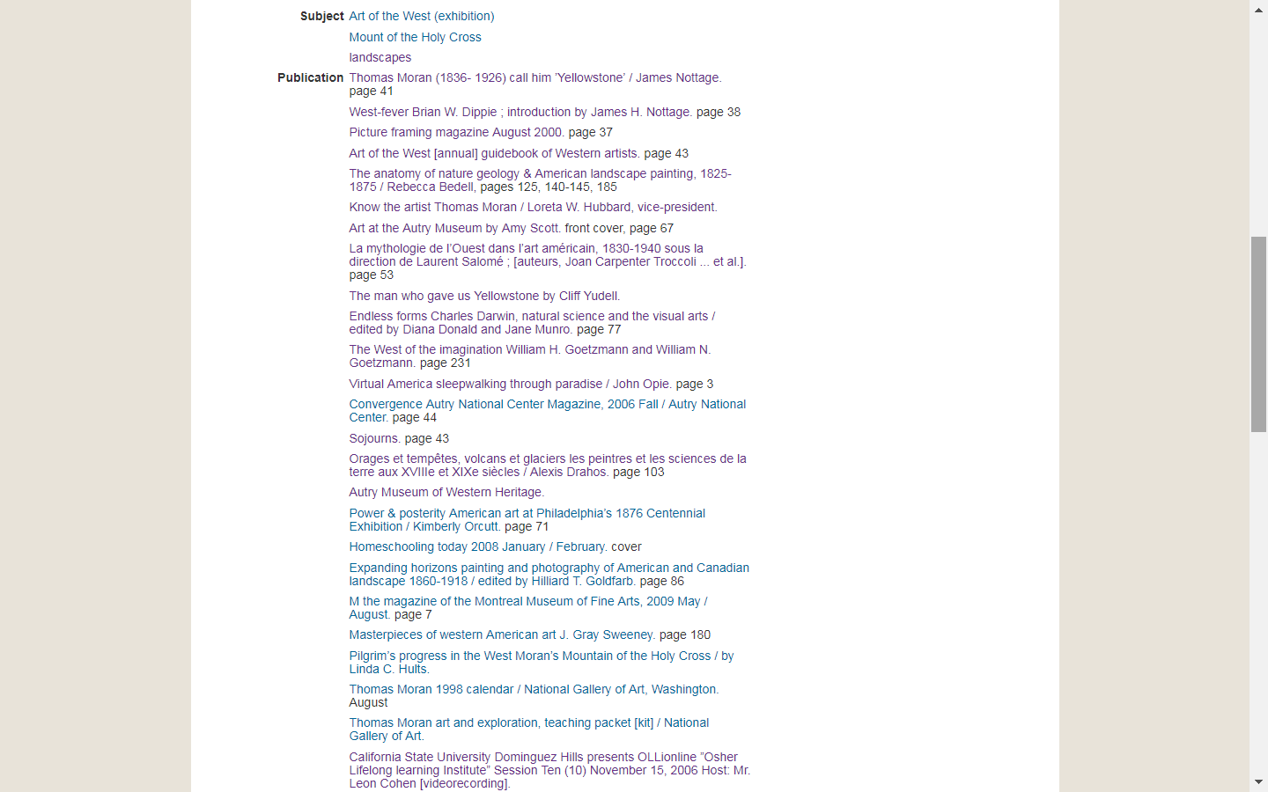
Linked Data and Collections: Exploring the Possibilities
Notes:
Cheryl
Linking these records began to reveal interesting patterns that could be discerned by evaluating the metadata about these objects and publications. For example, are there patterns with regard to date, country of publication, or subject focus of the publications, all data points that already exist. While the painting “Mountain of the Holy Cross” is reproduced mainly in art publications, it also appears in works on Natural Science, Architecture, and a picture framing magazine.

Slide 16
Linked Data and Collections: Exploring the Possibilities
Notes:
Cheryl
Kicking Bear’s ledger drawing of the Battle of Little Big Horn appears in works about Little Big Horn, works about the American West, works about Native American Artists, and works on historical thinking. Again, various data points already exist in the metadata.

Slide 17
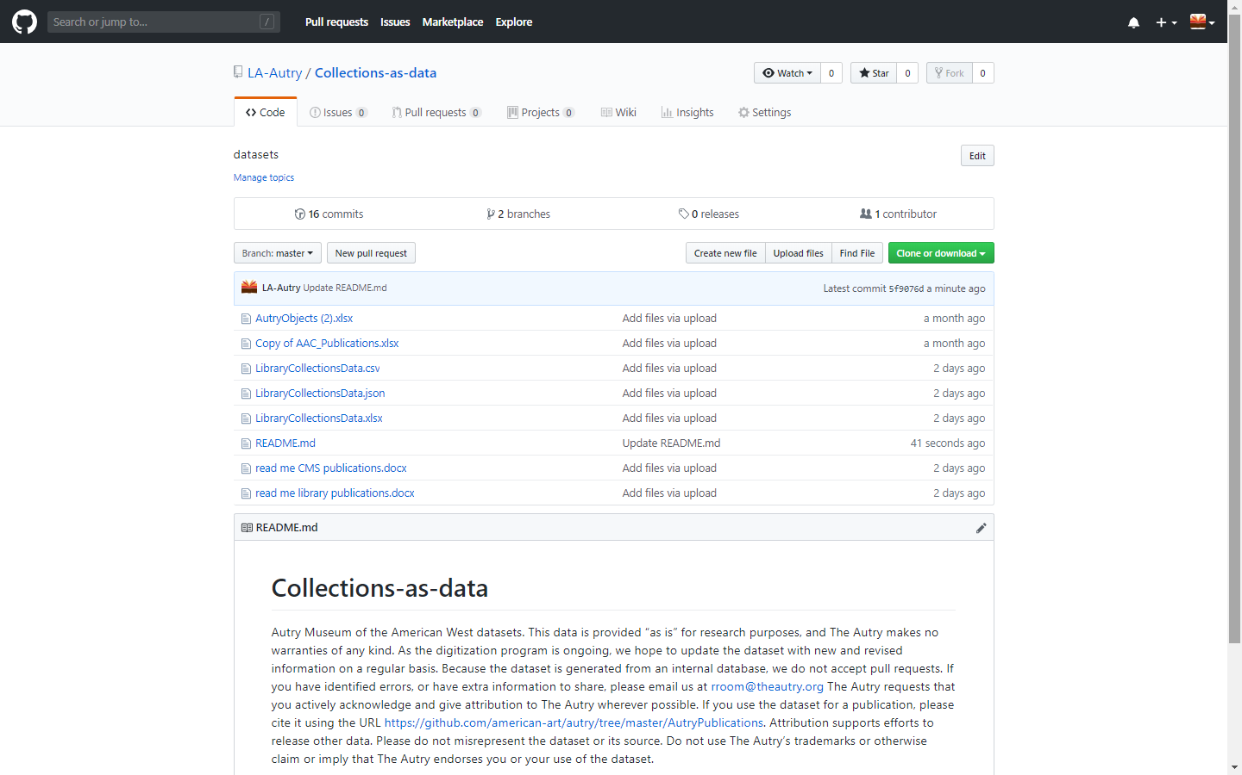
Linked Data and Collections: Exploring the Possibilities
Notes:
Cheryl
So why not make the relevant metadata available for researchers to analyze. We uploaded files GITHUB.

Slide 18
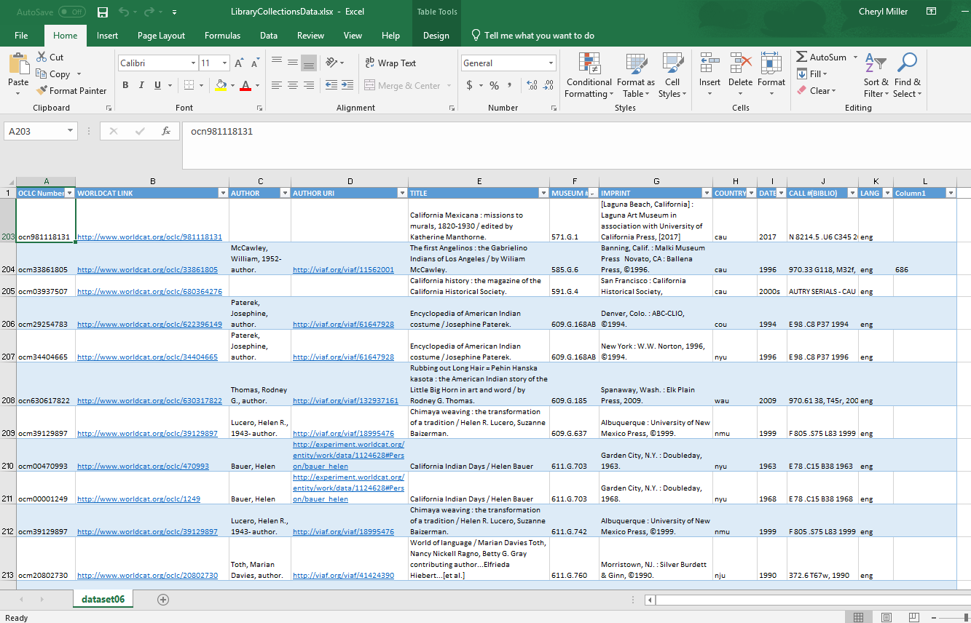
Linked Data and Collections: Exploring the Possibilities
Notes:
Cheryl:
This is an excel file loaded onto GITHUB, freely accessible for anyone to download.
This line of thinking of Collections as Data, while it came about due to the desire to repurpose edited metadata, was jumpstarted by the Autry’s participation in the American Art Collaborative Project.

Slide 19
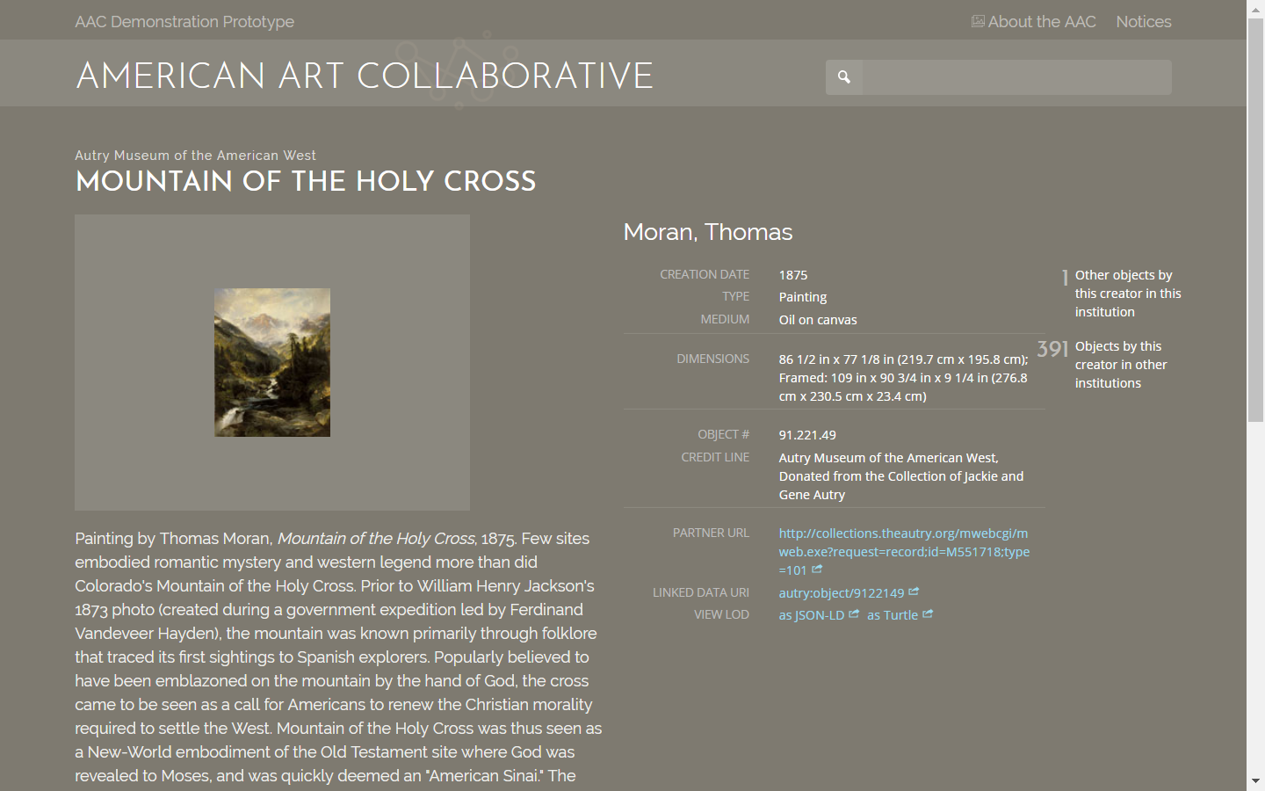
Linked Data and Collections: Exploring the Possibilities
Notes:
Rebecca:
Our membership in the American Art Collaborative, as Cheryl mentioned, pushed us to enter the world of collections as raw data.
The goals of the AAC include creating a diverse critical mass of Linked Open Data on the Web on the subject of American art and simplifying access to digital information across museum collections, to promote creative reuse of data on American art. AAC members converted data from various formats to rdf and developed a demo "browser" app to show the potential that a mass of linked open data could have.

Slide 20
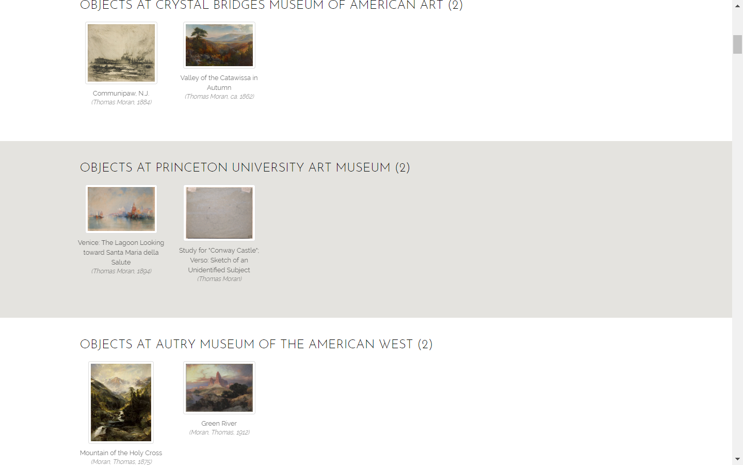
Linked Data and Collections: Exploring the Possibilities
Notes:
Rebecca:
Here you can see paintings by Thomas Moran appearing together, because each record includes the ULAN identifier for Thomas Moran.

Slide 21
Linked Data and Collections: Exploring the Possibilities
Notes:
Rebecca:

Slide 22
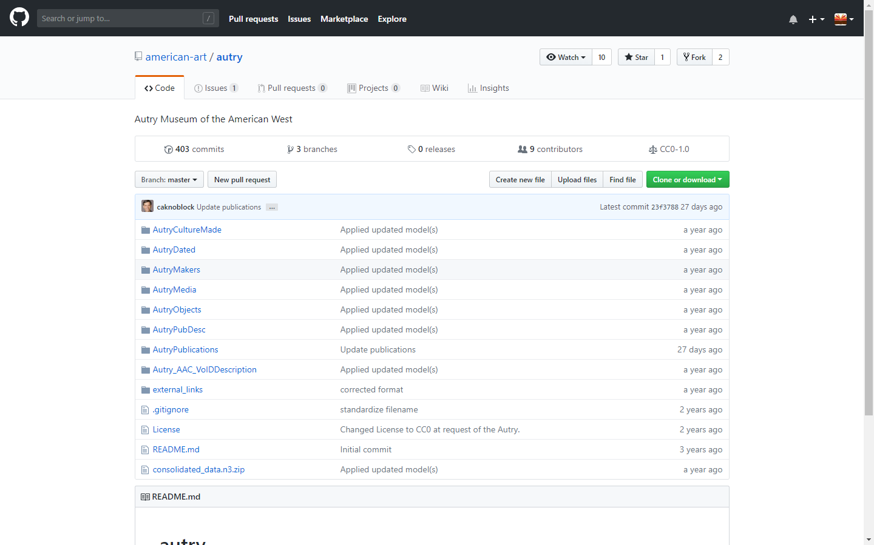
Linked Data and Collections: Exploring the Possibilities

Slide 23
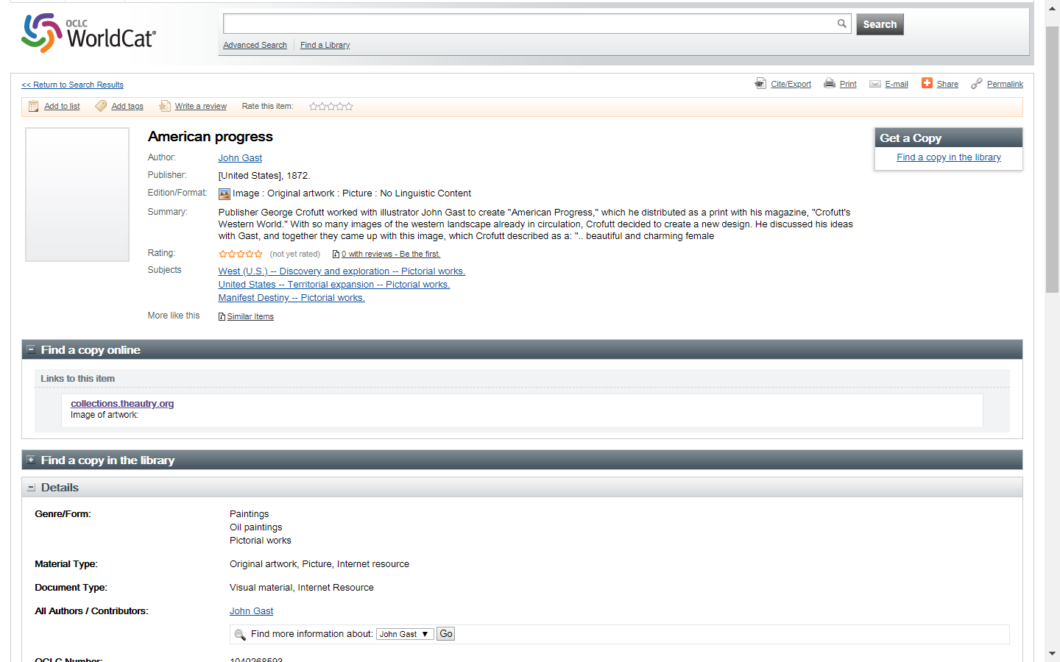
Linked Data and Collections: Exploring the Possibilities
Notes:
Cheryl
Looking to the future, linked data will allow a far more seamless linking of an Uniform Resource Identifier for the object to an Uniform Resource Identifier for the publication.

Slide 24
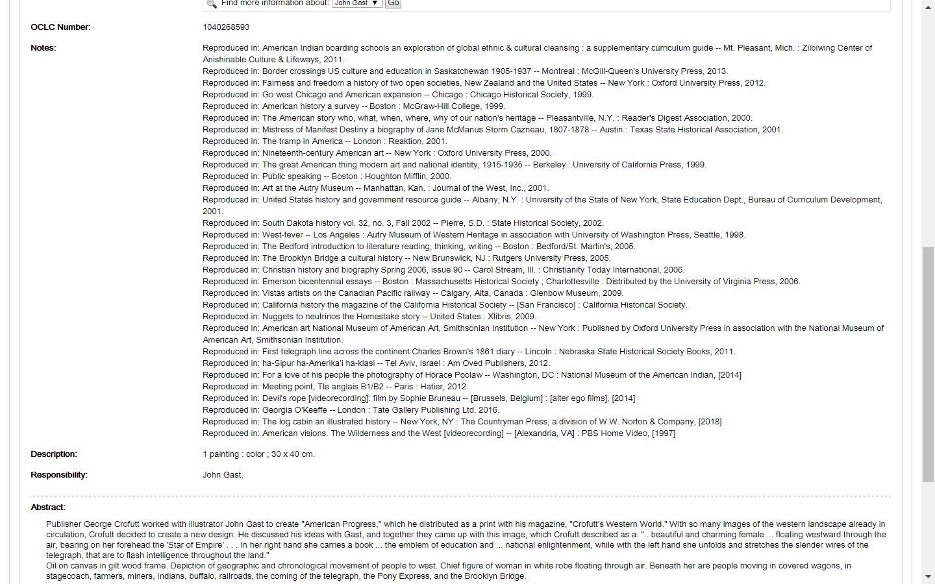
Linked Data and Collections: Exploring the Possibilities
Notes:
Cheryl
Persistent links to the publications could replace lengthy notes.

Slide 25
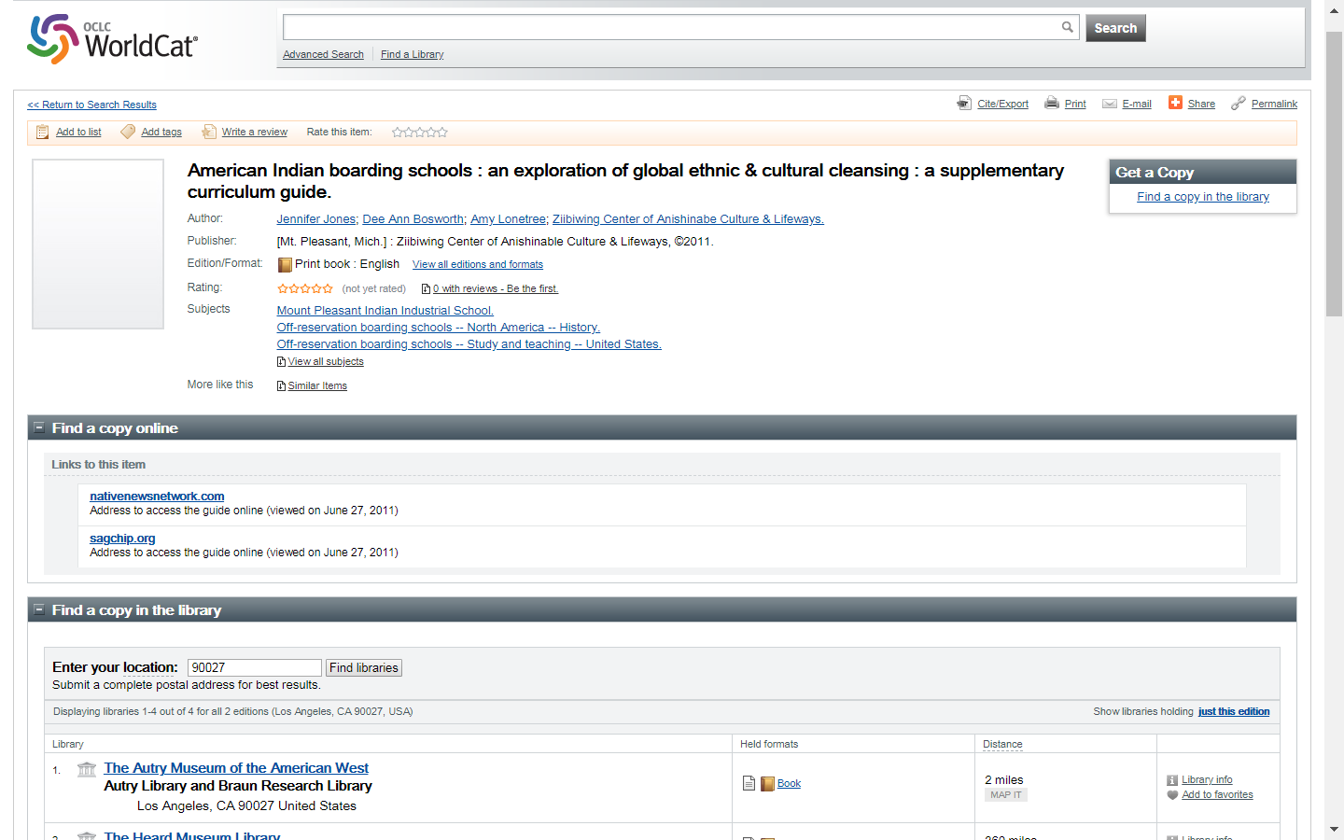
Linked Data and Collections: Exploring the Possibilities
Notes:
Cheryl
Similarly, we might encourage publishers to embed persistent Uniform Resource Identifiers in ebooks, offering a link back to the institution’s record for the objects or images.

Slide 26
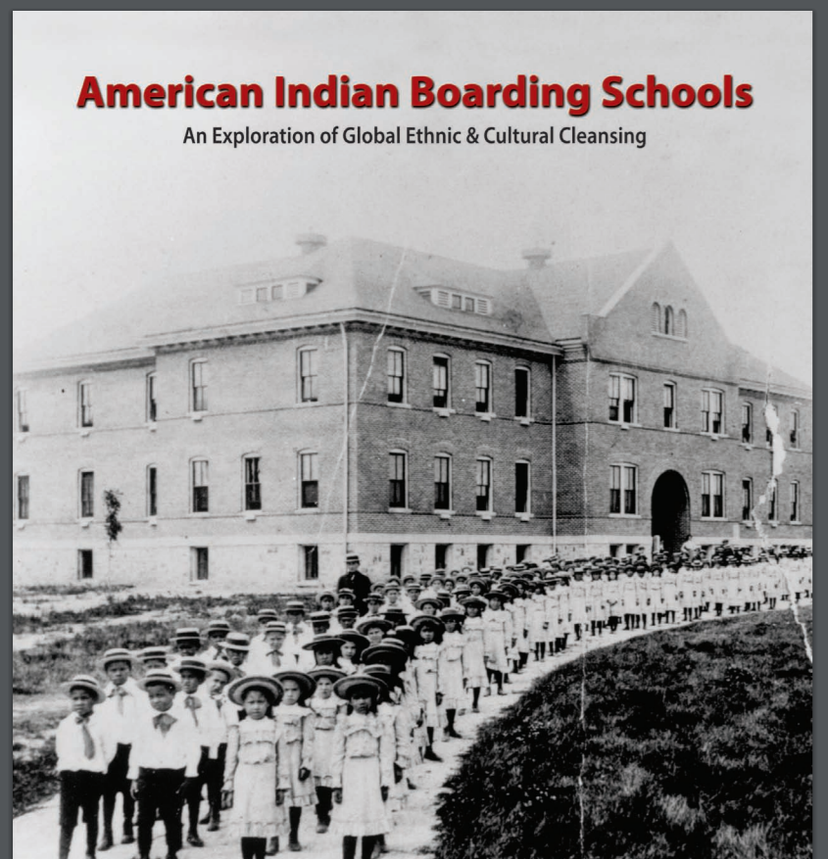
Linked Data and Collections: Exploring the Possibilities
Notes:
Cheryl
This publication includes a reproduction from the Autry Museum Braun Research Library Collections.

Slide 27
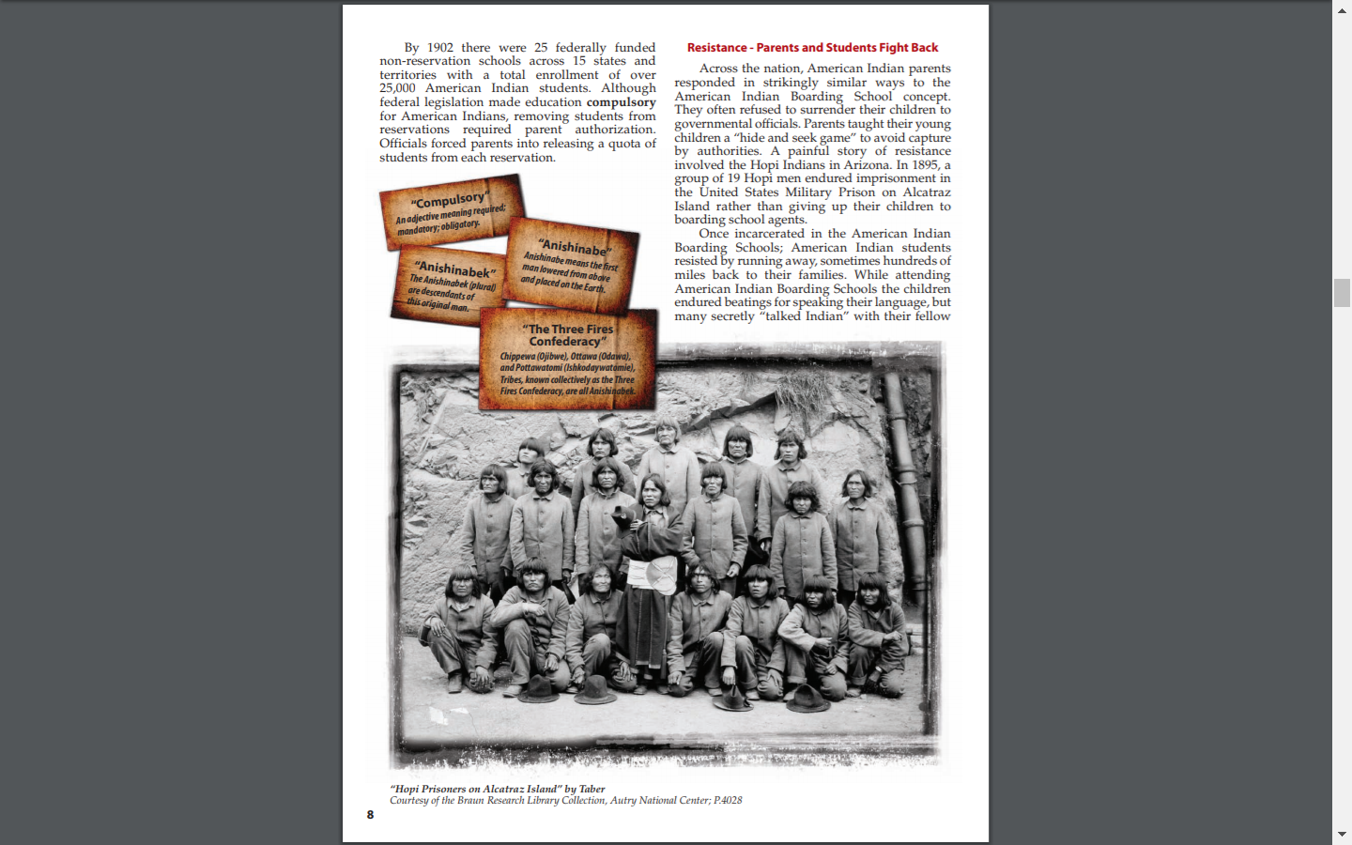
Linked Data and Collections: Exploring the Possibilities
Notes:
Cheryl:
Here it is presented with the author’s “interpretation” of the photograph. An embedded link to the Autry’s Collections Online site

Slide 28
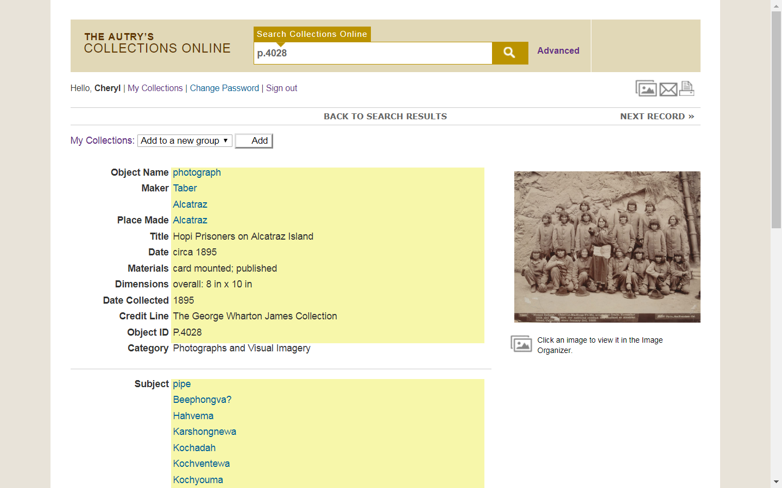
Linked Data and Collections: Exploring the Possibilities
Notes:
Cheryl
Could present an alternative view or interpretation of the image. Note: FYI the yellow squares indicate this record is available at researcher level on, access that requires an assigned login and password. Records are at this level mainly due to the metadata not yet being cleaned or reviewed. The Autry has a third level of access for cultural sensitive items, which might be accessible only by approved tribal members. Any records linked from ebooks would be fully accessible.

Slide 29
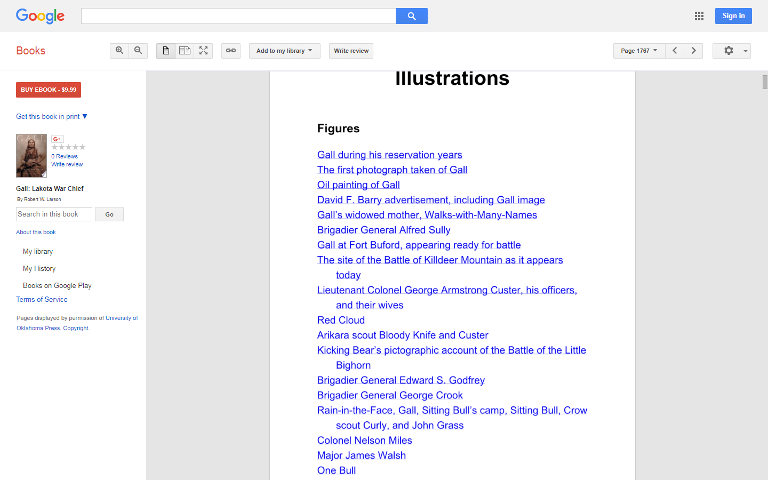
Linked Data and Collections: Exploring the Possibilities
Notes:
Cheryl
The e-book edition of Gall: Lakota War Chief already includes hyperlinks to images within the e-book. A link could be added to the “Kicking Bear’s” entry.

Slide 30
Linked Data and Collections: Exploring the Possibilities
Notes:
Cheryl: Opening the source record in Collections Online.

Slide 31
Linked Data and Collections: Exploring the Possibilities
To recap:
Linking the MIMSY XG (Collections Management System) publication record to the relevant object records and to the MARC library catalog record
Object display in Autry’s Collections Online: Variant interpretations of the artifacts and images
Publication display in Autry’s Collections Online: approaching a virtual exhibition, curated by the author
What connections might future linked data and collections as data options reveal?
Creative work records in WorldCat and other databases Links in e-books and in WorldCat
Data visualization, mapping, or image analysis

Slide 32
Linked Data and Collections: Exploring the Possibilities
Resources and Sources Cited
https://collectionsasdata.github.io/
https://github.com/american-art/autry
https://groups.google.com/forum/#!forum/collectionsasdata
https://www.zotero.org/groups/2171423/collections_as_data_-_projects_initiatives_readings_tools_datasets
http://www.6floors.org/bracket/2018/11/01/thinking-with-linked-data-representing-history/
https://blogs.loc.gov/thesignal/2017/08/collections-as-data-and-national-digital-initiatives/
https://www.youtube.com/watch?v=ENaPV2XmO9I
https://datacurationnetwork.org/
https://guide.dhcuration.org/
https://iswc2017.ai.wu.ac.at/wp-content/uploads/papers/MainProceedings/382.pdf

